Slide 1
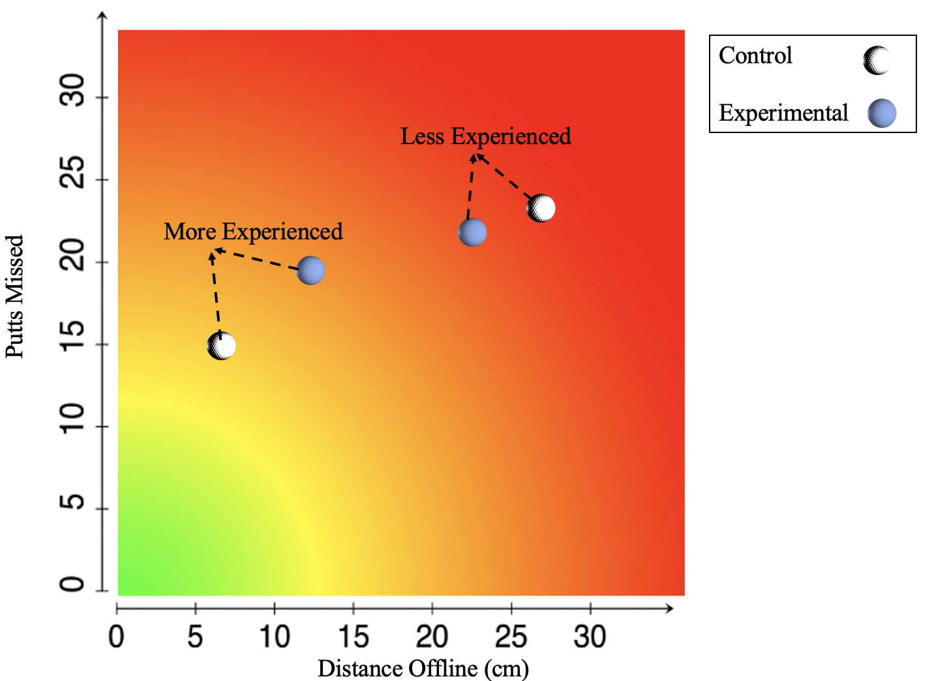
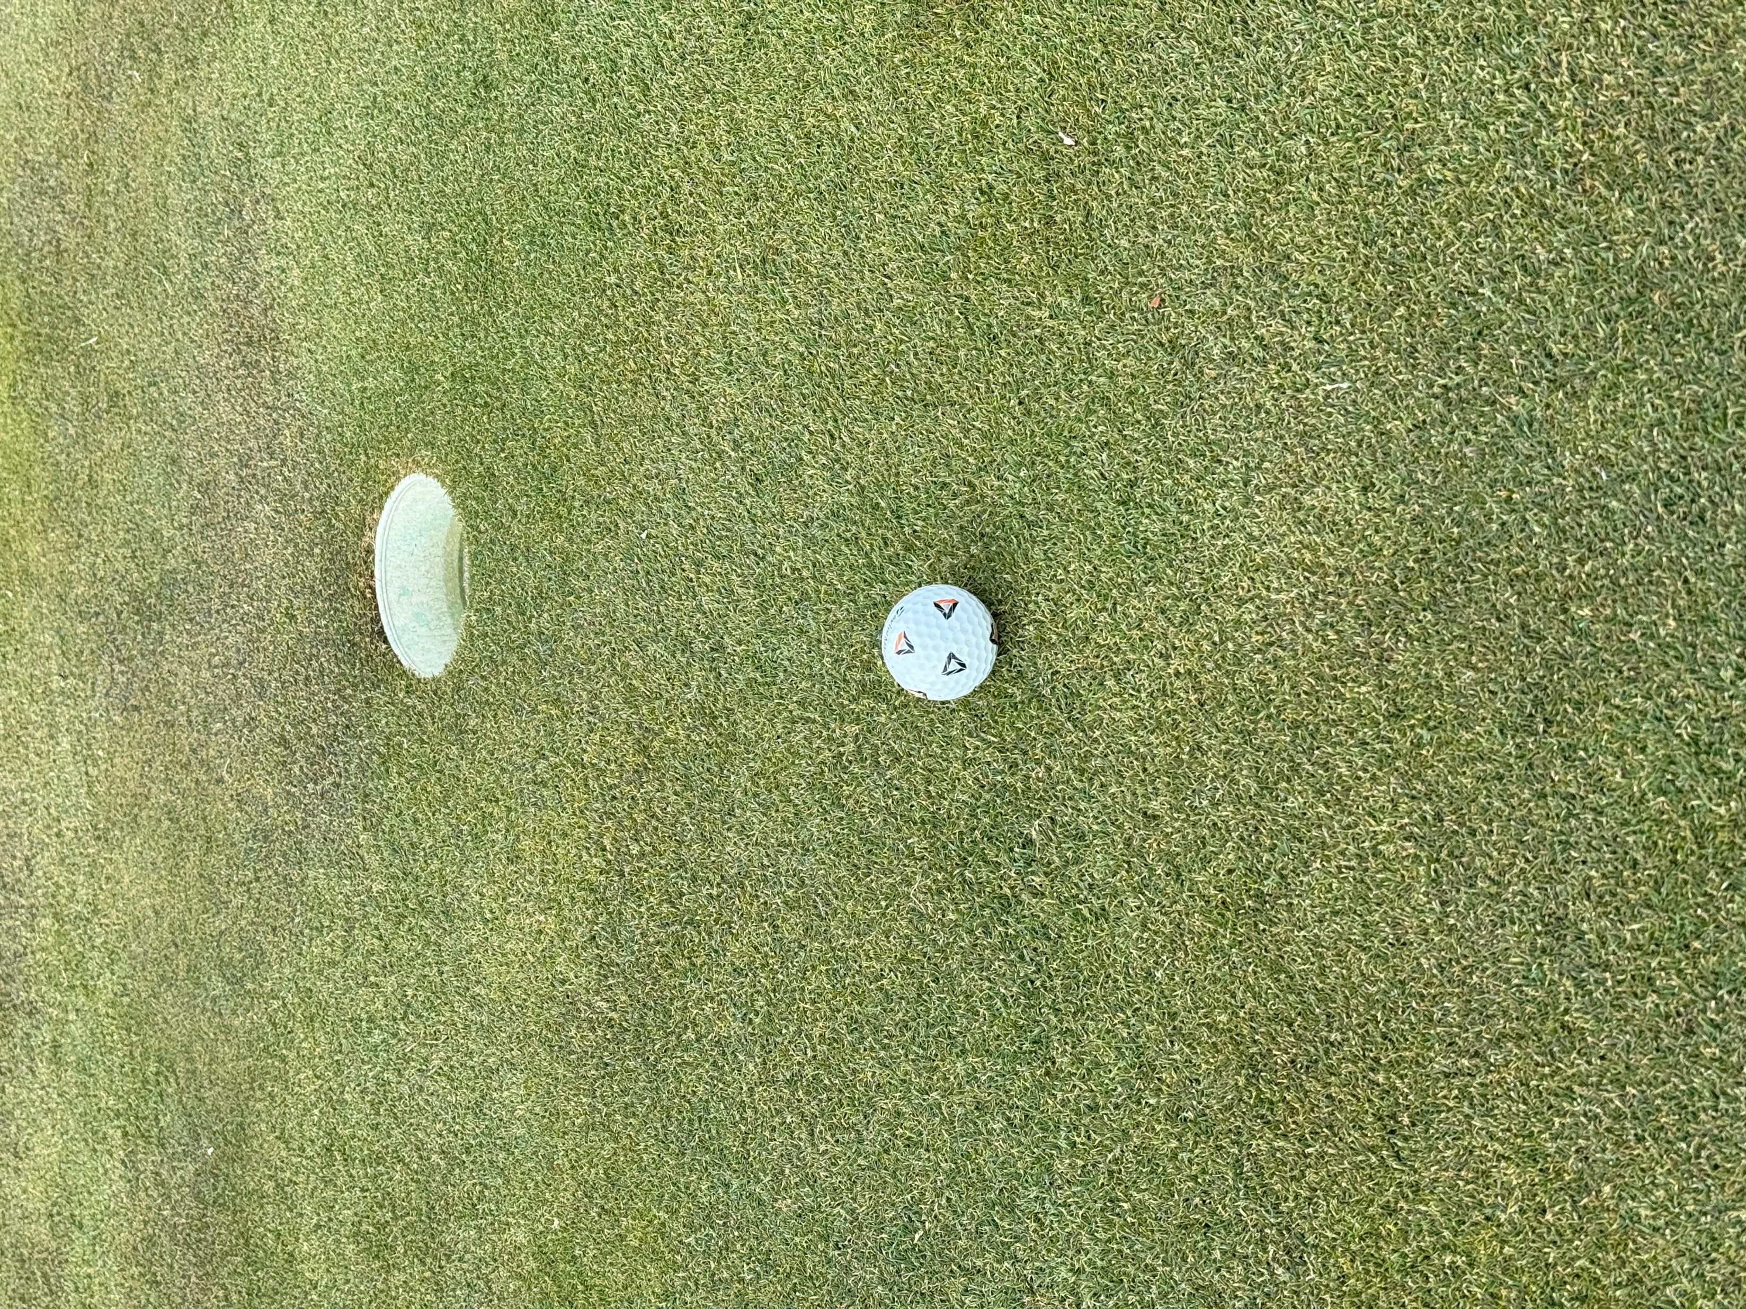
The Effects of Mental Fatigue on Putting Performance in Male Recreational Golfers
Zachariah Bradley, Samuel Shaver, Gannon White & Brent Alumbaugh
Department of Kinesiology, Colorado Mesa University, Grand Junction, Colorado
INTRODUCTION
Golf is commonly referred to as a mental sport because it requires a significant amount of concentration. Mental fatigue has been shown to decrease performance in many exercise related tasks. However, there is limited information of its impact on accuracy of a golf putt in recreational golfers. This study aims to target the effects of mental fatigue in golfers on their performance in completing three separate distance putts. The motivation behind this study involves finding whether mental fatigue affects golf putting performance. If so, training regimens could be implemented to train while mentally fatigued to elicit higher performance for recreational, collegiate, and pros alike.
METHODS
Eight recreational male golfers over two sessions; an experimental condition where the golfers were administered a mentally fatiguing task (30-minute Stroop test), and a control session (30 minutes of self-selected music). In both sessions, participants completed the Brunell mood questionnaire (BRUMS) that was used to gauge mental fatigue level in participants. Eight emotions measured for mental fatigue were broken into two subcategories, fatigue and vigor. The sum of scores for pre and post control and experimental conditions were collected and used in data analysis. Twelve putts were then completed each 1, 2, and 3 meters from the hole. Time to putt (TTP), average distance offline, as well as the number of putts made were measured and used for data analysis. `
RESULTS
Brums test results for fatigue were significantly different between control (1.75 ± 1.58) and experimental (5.87 ± 4.12) (p=.03). Similarly, Brums test results for vigor were significantly different between control (7.74 ± 3.88) and experimental (4.37 ± 1.99) (p=.04). There was no significant difference in TTP at any distance, distance offline at or putts made overall from control to experimental (p>.05).
DISCUSSION
The results of this study have provided insight to whether mental fatigue can affect performance in golf putting, specifically in TTP and distance offline or putts made in recreational male golfers. The results demonstrate that putting performance appears to be unaffected by mental fatigue in recreational golfers. While it was not tested in this study, it is possible that mental fatigue may play a role in the average distance offline in putts 4 meters or longer. Although there was little difference in putting performance during the experimental condition, it was clear that mental fatigue was achieved during the experimental trial. The results show significant (p<.05) impairments in vigor as well as elevated fatigue levels. This further validates the Stroop test and its ability to elicit mental fatigue, suggesting any differences in control to experimental conditions can be attributed to increased mental fatigue. After further investigation, attempts were made to divide the more experienced golfers from the less experienced golfers. More experienced golfers subsequently showed a greater negative reaction to Stroop test. Less experienced golfers were also affected by the Stroop test but did not trend either towards becoming more or less accurate.
CONCLUSIONS
This study found no difference in TTP across all distances in control versus experimental trials. Additionally, there was no difference in distance offline in the one-, two-, or three-meter putts in control versus experimental trials, as well as overall putts made. A homogenous group such as a pro or collegiate team, or even high scoring recreational golfers (75-90 across 18 holes) might reveal greater decreased putting accuracy and increased TTP due to less variation in skill level amongst the participants.
Figure 1A and 1B. Post experimental mental fatigue scores are statistically significantly higher. Post experimental vigor scores are statistically significantly lower.
Figure 2A and 2B. Average distance offline and time to putt in the control versus experimental groups.
38 cm
Figure 3. Average putts missed and distance offline in both control and experimental trials, comparing more experienced and less experienced golfers.
Figure 4. Example of distance offline measurement in cm, measured from center of ball to closest edge of the cup.

