Slide 1
Colorado River Issues
Western Colorado Food and Farm Forum January 22, 2022
Hannah Holm, Director
Notes:
The Colorado Basin Roundtable is one of 9 basin roundtables of stakeholders in the state formed in 2005 by the state legislature to do “bottom-up” water planning.
SGM is the company leading the planning effort for the Colorado Basin Roundtable that we are discussing today.
The Water Center at CMU, which I coordinate, is helping lead the public outreach and participation process.

Slide 2
Mission: to perform and facilitate interdisciplinary and collaborative research, education, outreach and dialogue to address the water issues facing the Upper Colorado River Basin.
www.ColoradoMesa.Edu/Water-Center

Slide 3
Presentation Outline
Colorado River
Historic Over-allocation
Recent Water Supply Trends
Policy Responses
Implications for Local Water Users
What conditions have you seen?
Options

Slide 4
Colorado River Basin
Source: US Bureau of Reclamation

Slide 5
The basic story of the Colorado River:
Over-
Allocation
7.5 + 7.5 + 1.5 = 16.5

Slide 6
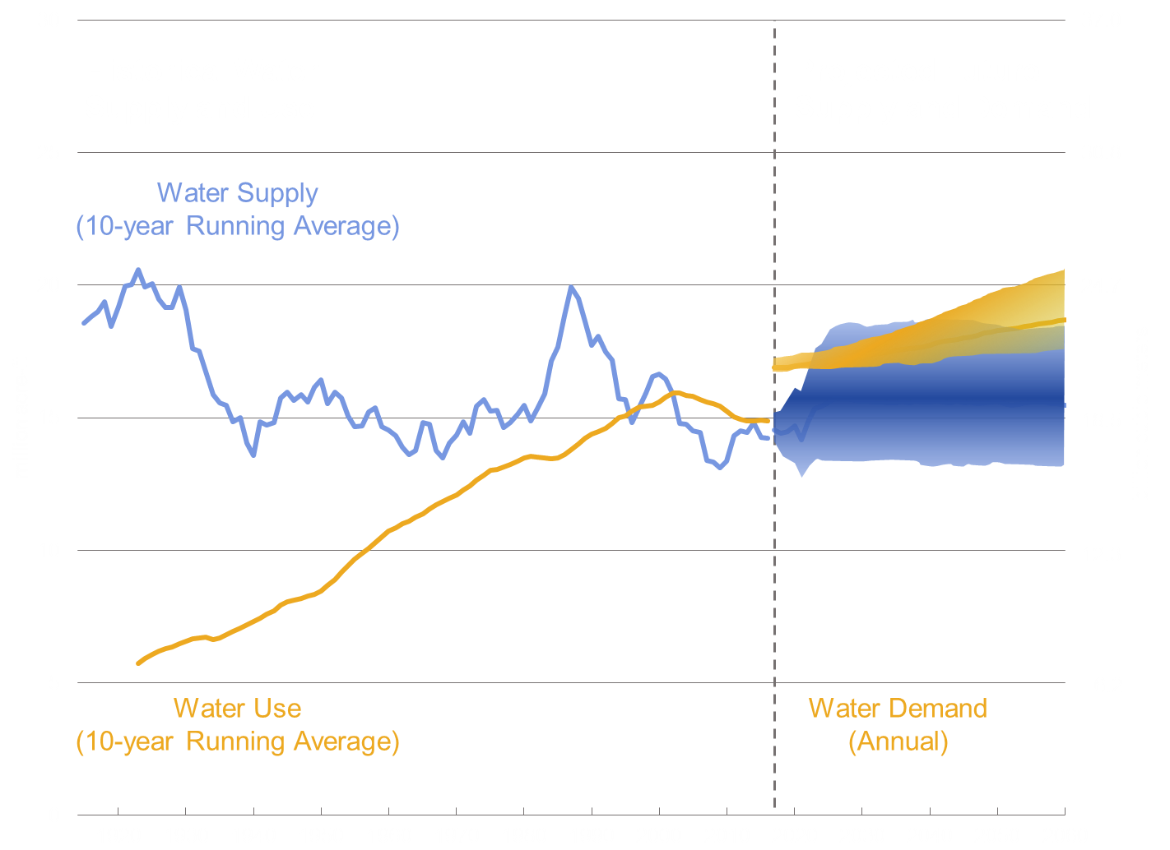
How did we manage to live with an over-allocated system for almost 100 years?
Source: Bureau of Reclamation – Alan Butler presentation at 2018 Upper Colorado River Basin Water Forum
It took awhile for everyone but California to grow into their allocations, we have really big reservoirs – and the Upper Basin is still consuming much less than 7.5 million acre-feet/ year.

Slide 7
Steps towards balance
2003 Quantification Settlement Agreement
Brought CA within its 4.4 maf allotment
Ag – Urban transfers
2007 Interim Guidelines
Authorized “Intentionally Created Surplus” for storing water in Mead
Determined official shortage levels that would require delivery cuts. (required in 2022)
2019 Drought Contingency Plan
More aggressive triggers for delivery cuts in Lower Basin (required in 2020)
Plan for a plan in the Upper Basin (Demand Management pool)

Slide 8
It hasn’t been enough (even without resolving undeveloped tribal water rights).
Source: John Fleck and Anne Castle, “Green Light for Adaptive Policies on the Colorado River,” in
Water, December 2021 (Chart constructed with Bureau of Reclamation data.)

Slide 9
Total Colorado River Storage dropped from 48% of capacity to 38% from 2020-2021.
Source: Bureau of Reclamation DRAFT Annual Operating Plan for Colorado River Reservoirs 2022

Slide 10
Steps towards balance
2003 Quantification Settlement Agreement
Brought CA within its 4.4 maf allotment
Ag – Urban transfers
2007 Interim Guidelines
Authorized “Intentionally Created Surplus” for storing water in Mead
Determined official shortage levels that would require delivery cuts. (req. in 2022)
2019 Drought Contingency Plan
More aggressive triggers for delivery cuts in Lower Basin (req. in 2020)
Plan for a plan in the Upper Basin (Demand Management pool)
2021-2022: Scrambling
Drought Response Operations Agreement releases in 2021
Lower Basin “500+ Plan”
Powell releases cut in early 2022

Slide 11
Current Policy Decision-Making
Upper Basin Determining whether to do Demand Management Program (temporary, voluntary, compensated reductions in use)
Re-negotiation of the 2007 Guidelines (expire in 2026)

Slide 12
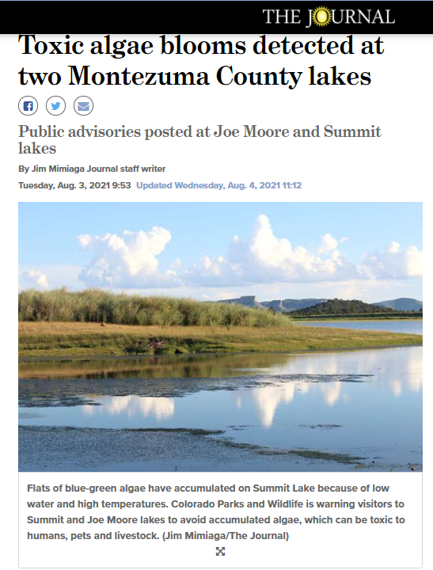
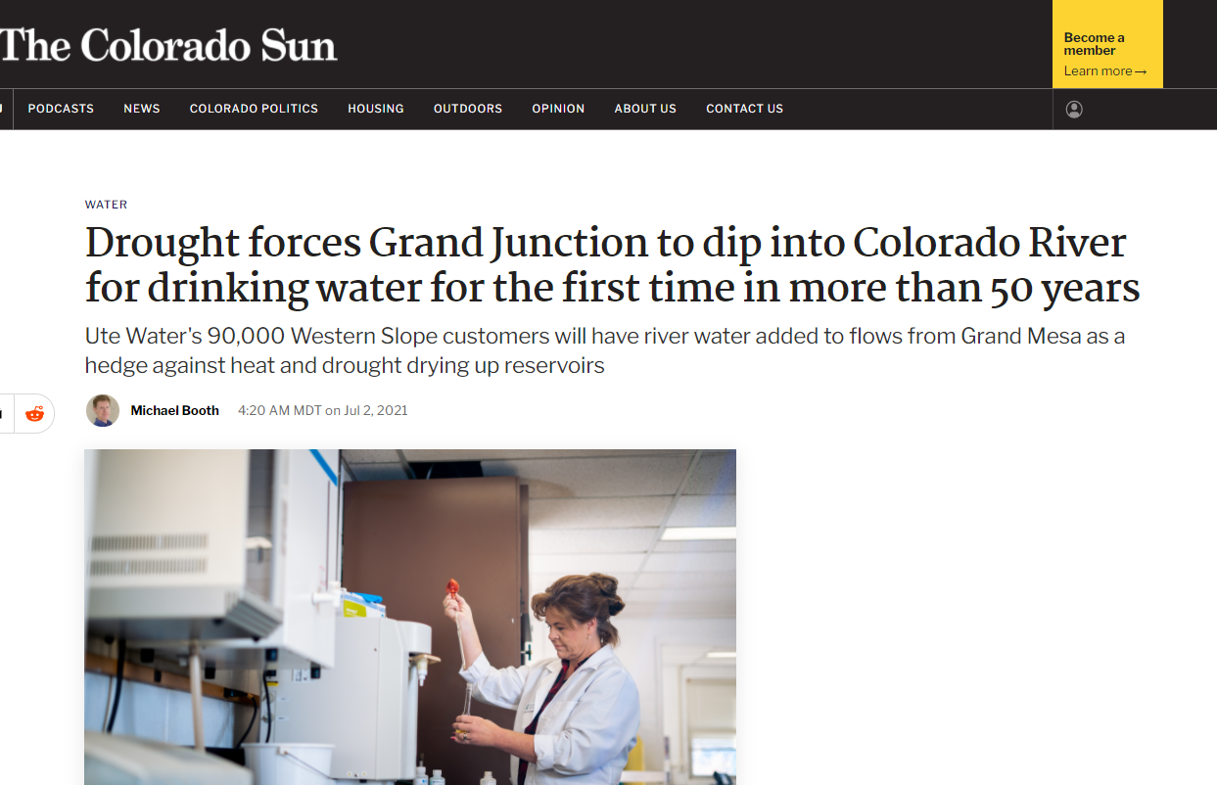
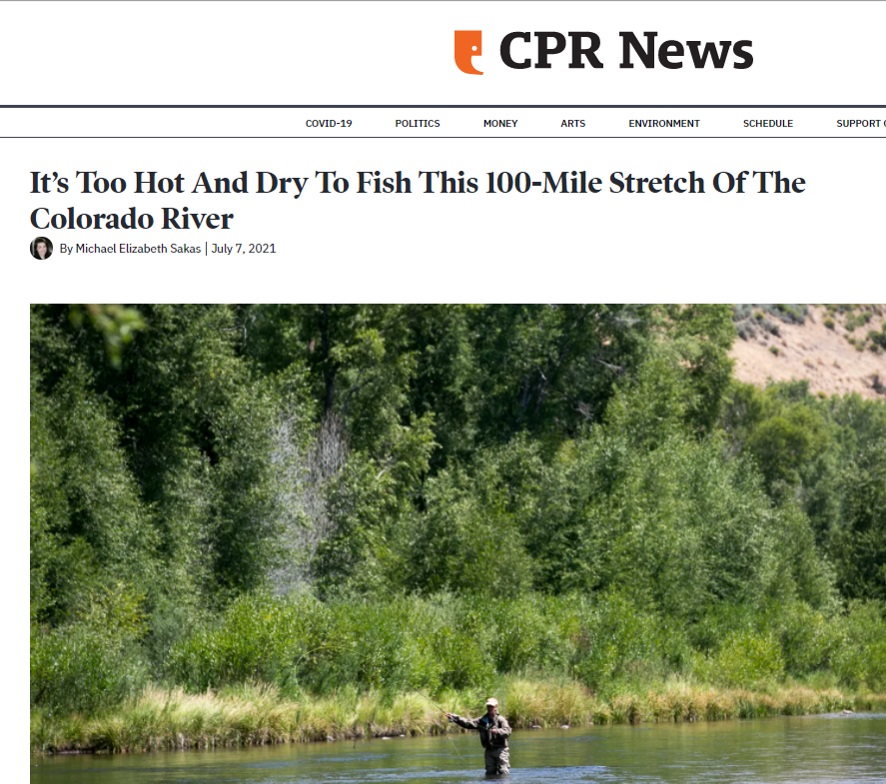
Meanwhile, upstream…

Slide 13
Opportunities/ Options
Infrastructure improvements (federal infrastructure funding)
Watershed & forest health restoration
Alternative Transfer Methods
Soil health
Water banking/ shortage sharing (examples in Utah and New Mexico)
Local multi-benefit project example: http://coloradowatertrust.org/project/15-mile-reach Resource: https://www.tenstrategies.net/

Slide 14
www.ColoradoMesa.edu/Water-Center
Hannah Holm
hholm@coloradomesa.edu

