Slide 1


Negotiating our Water Future in Colorado & the Colorado River Basin
Colorado’s Water Plan & the Colorado & Gunnison Basin Plans
March 2015 Update
Presentation developed for the Colorado and Gunnison Basin Roundtables by:
George Sibley, Gunnison BRT Education Committee Chair
Notes:
The Colorado Basin Roundtable is one of 9 basin roundtables of stakeholders in the state formed in 2005 by the state legislature to do “bottom-up” water planning.
SGM is the company leading the planning effort for the Colorado Basin Roundtable that we are discussing today.
The Water Center at CMU is helping lead the public outreach and participation process.

Slide 2
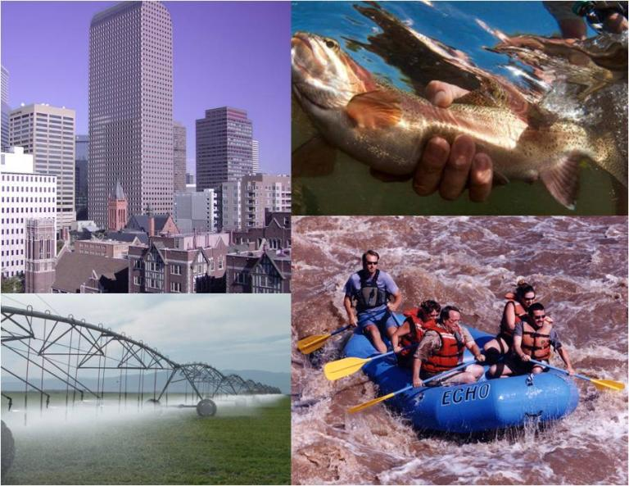
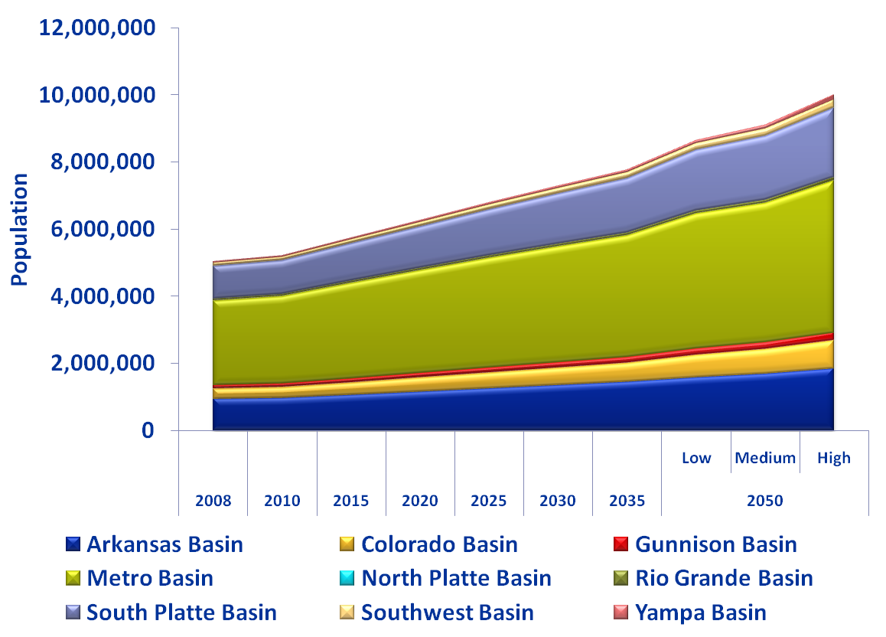
Why write a Colorado Water Plan?
Our population is increasing but there’s no new water.
Environment
Municipal 7%
Industrial 4%
Many uses compete for a limited water supply.
Agriculture 89%
Recreation
Graphics provided by the Colorado Foundation for Water Education; percentages are for the amount of water consumed (not just diverted) in Colorado, according to the draft Colorado Water Plan.
Notes:
As you are probably aware, we are entering an era of increasing competition for water.
Agriculture is currently by far the largest user of water in the state.
Municipal use is where the largest growth is expected.
Water to sustain the environment and provide recreation don’t deplete streams, but water rights to ensure those functions can limit other uses.

Slide 3
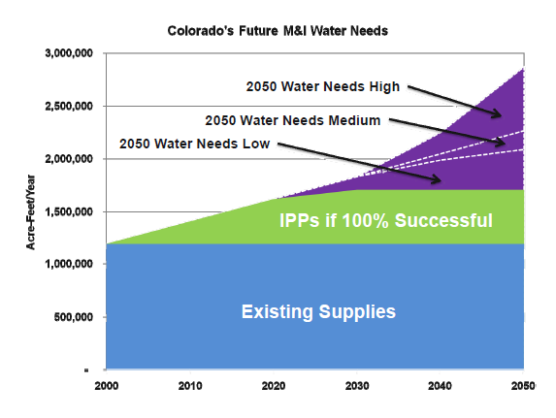
Colorado is facing a future“Gap”
Notes:
All areas of the state have projected gaps, but the size of the gap is the largest on the Front Range.
Current (Colorado Basin) demand 62,000 acre-feet which can increase to ~120,000 acre-feet in the future
This graph just shows the urban water gap – many argue that we also already have substantial gaps in meeting agricultural and environmental needs.
In the Colorado Basin:
Shortage of 100,000 acre-feet of water to support irrigated agriculture
There is also a non-consumptive gap in the Colorado River Basin, although it hasn’t been quantified.

Slide 4
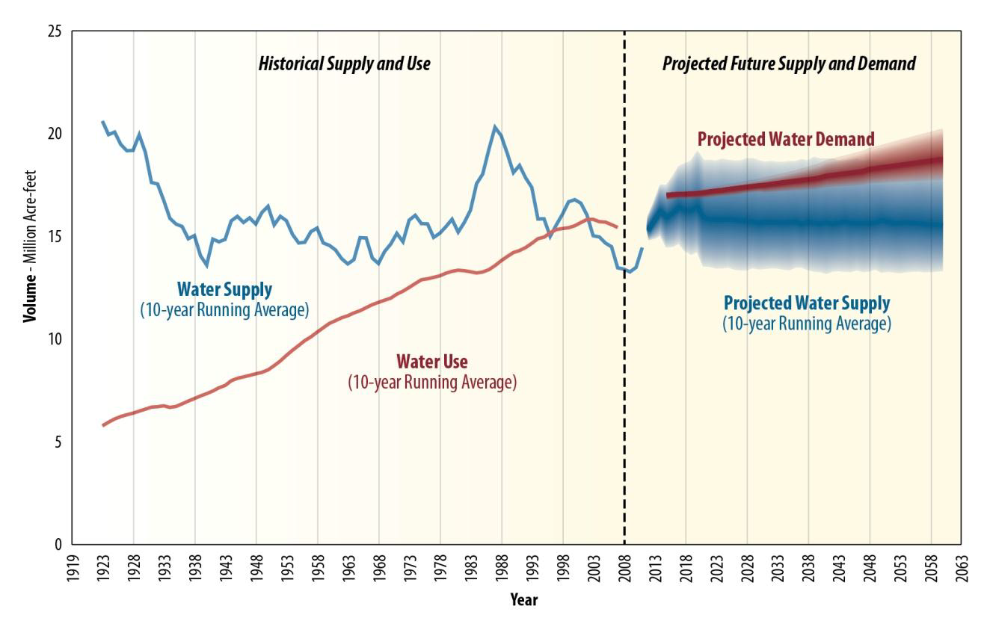
Colorado Basin-wide Gap: Now and Bigger
Source: US Bureau of Reclamation Colorado River Basin Supply and Demand Study, 2012
Notes:
Basinwide, annual water use has already begun to exceed annual inflows of water into the system – a situation permitted by the extensive reservoir storage in the basin.
The lower basin is using more than its allocation; the upper basin hasn’t yet reached full use of its allocation.

Slide 5

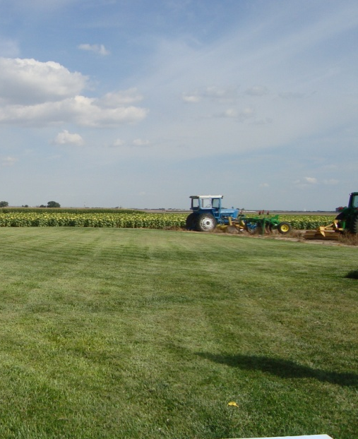
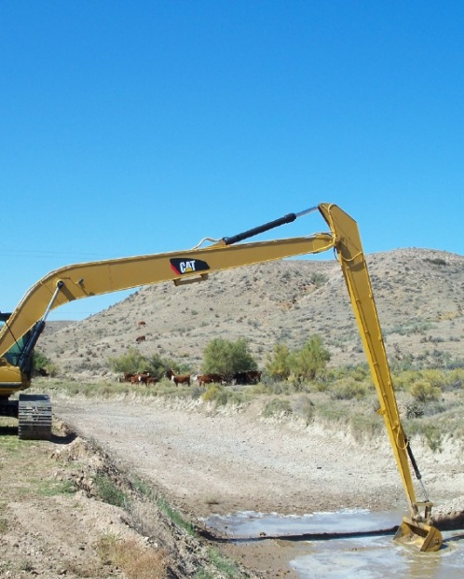
How can we fill Colorado’s gap?
Already planned projects (Windy Gap firming, Moffat Collection System) +
Conservation
Ag to Urban Transfers
New Projects
(Colorado Basin development)
Draft CO Water Plan completed December 2014; Final plan is due December 2015.
Graphics provided by the Colorado Foundation for Water Education
Notes:
The Colorado Water Conservation Board and the Inter-Basin Compact Committee (a Roundtable of Roundtables) have identified these “four legs of the stool” for filling the gap. None of these tools are without costs:
to achieve ambitious conservation goals is difficult without new regulations and addressing touchy land-use issues;
“buy and dry” has devastated some eastern plains communities;
the headwaters are already suffering from transmountain diversions.

Slide 6
Colorado Water Plan Goals:
A productive economy that supports:
    vibrant and sustainable cities.
    viable and productive agriculture.
    a robust skiing, recreation and tourism industry.
Efficient and effective water infrastructure promoting smart land use.
A strong environment that includes healthy watersheds, rivers and streams, and wildlife.
Source: Governor Hickenlooper’s Executive Order for Colorado’s Water Plan.

Slide 7
How, for an uncertain future?
No & Low Regret Actions in the draft CO Water Plan:
  Minimize permanent “buy & dry” of ag lands by supporting lower-impact alternatives.
  Plan and preserve options for developing unallocated water on the Western Slope.
  Establish (at least) medium conservation strategies.
  Implement projects to support environmental and recreational uses.
  Support projects that are already planned.
  Implement storage and other infrastructure projects.
  Implement water re-use strategies.

Slide 8
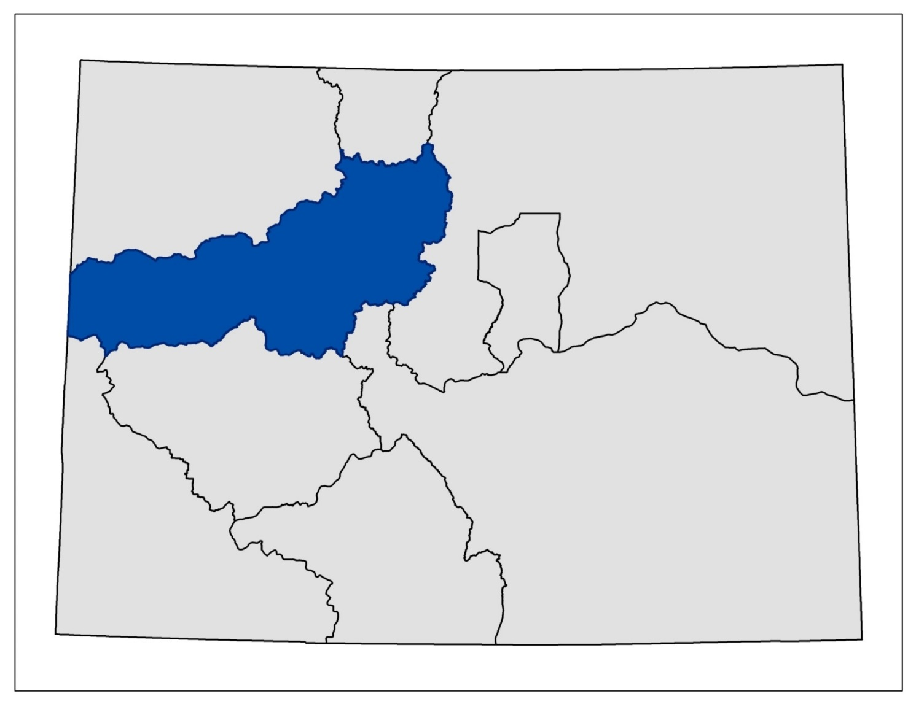
Details left to Basin Roundtables
North
Platte
Yampa/White
South Platte
Colorado
Metro
Gunnison
Arkansas
Rio Grande
Southwest
East and West Slope Roundtables differ
on potential for additional trans-mountain diversions.

Slide 9
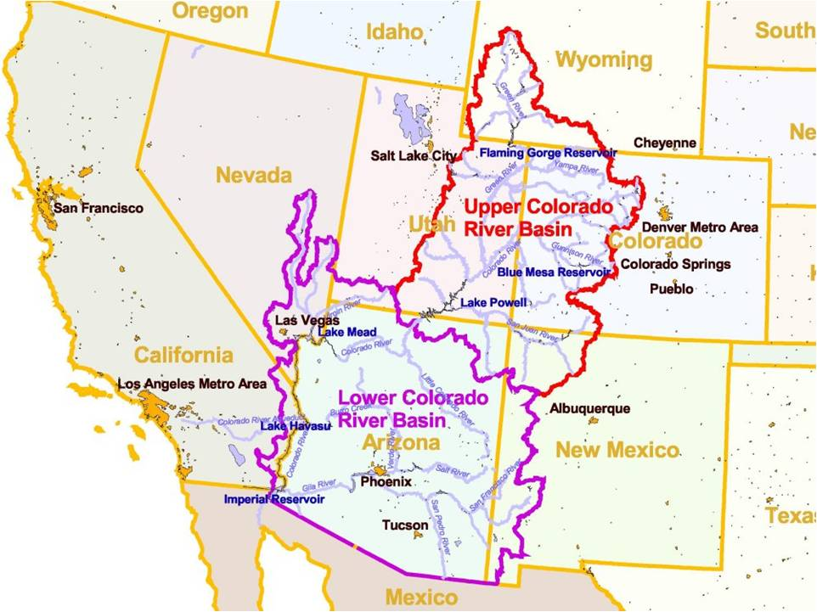
Downstream obligations a major concern:
1922 Compact
Upper Basin must allow 75 maf/ 10yrs to pass Lee Ferry.
Power Pool in Powell
3,490 elevation is necessary for Lake Powell to keep generating hydropower (elevation was 3,593.29 on 2/7/15).

Slide 10
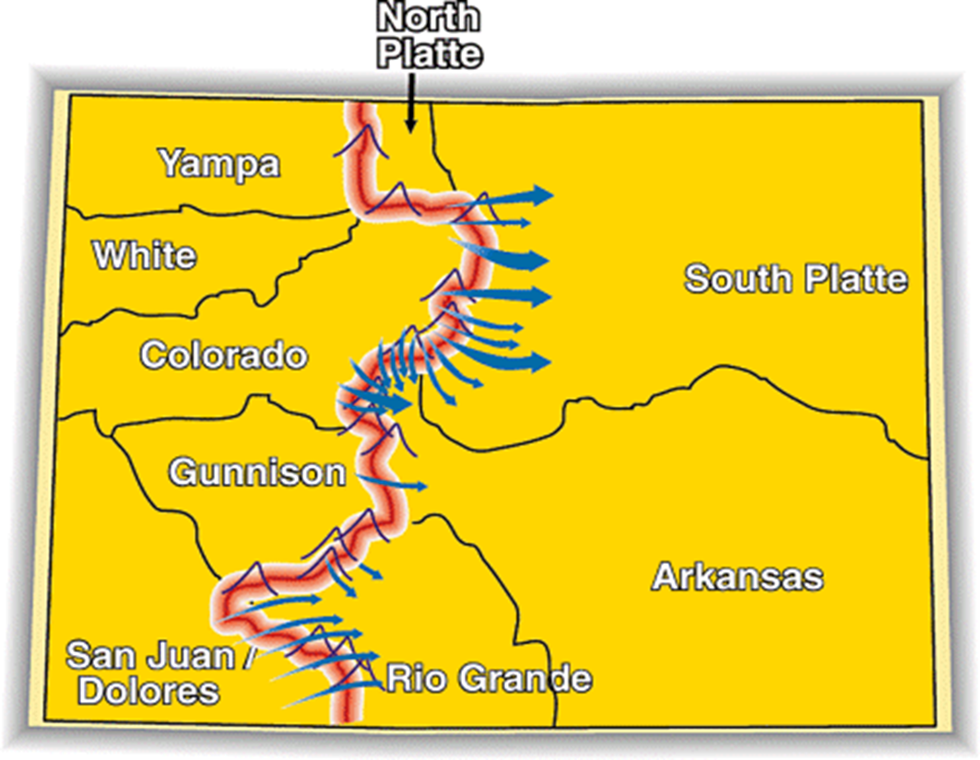
Conceptual Framework for negotiations on a future TMD:
Existing Transmountain Diversions
East Slope not looking for a firm yield & would accept hydrologic risk.
A new TMD would be used conjunctively with non-West Slope water (interruptible supply agreements, aquifers, etc).
To manage when a new TMD could divert, triggers are needed.
An insurance policy that protects against involuntary curtailment is needed for existing uses and some future development, but will not cover a new TMD.
Future West Slope needs should be accommodated as part of a new TMD project.
Colorado will continue its commitment to improve conservation and reuse.
Environmental resiliency and recreational needs must be addressed both before and with a new TMD.
Summarized from the draft Colorado Water Plan

Slide 11
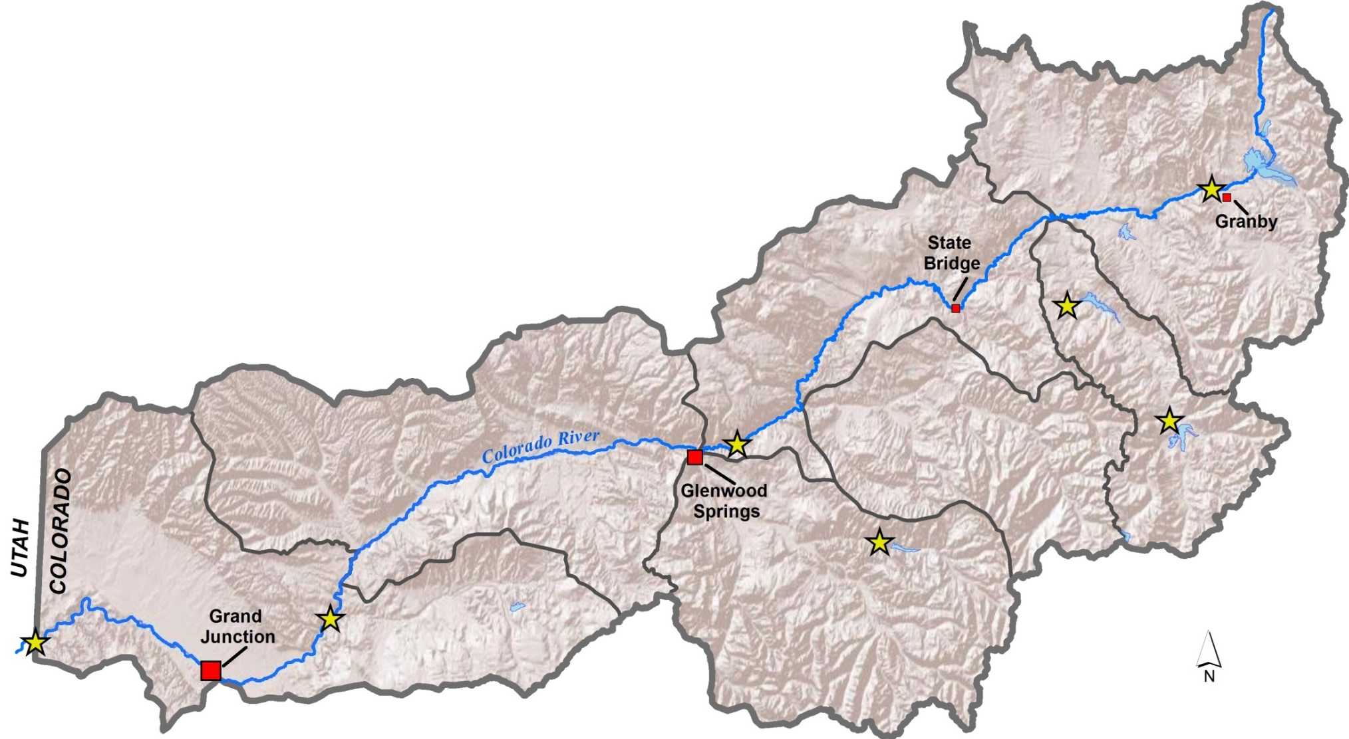
Colorado Basin Plan – 7 Regions
Grand County
Summit
Eagle River
State Bridge
Roaring Fork
Middle Colorado
Grand Valley
Grand County
State
Bridge
Summit
Middle Colorado
Eagle River
Grand Valley
Roaring Fork

Slide 12
Colorado Basin Plan Themes
Protect & Restore Healthy Streams, Rivers, Lakes and Riparian Areas
Sustain Agriculture
Secure Safe Drinking water
Develop Local Water Conscious Land Use Strategies
Assure Dependable Basin Administration
Encourage High Level of Basinwide Conservation

Slide 13
Themes with Supporting Goals
Protect and Restore Healthy Streams, Rivers, Lakes and Riparian Areas
Protect and rehabilitate healthy rivers, streams, lakes and riparian areas. Define water quality needs and at-risk water bodies. Preserve high quality recreational river and stream reaches with appropriate flows. Develop a basinwide funding system to meet basin environmental and recreational needs.
Sustain Agriculture
Reduce agricultural water shortages Minimize potential for transfer of agricultural water rights to municipal uses. Develop incentives to support agricultural production. Increase education among the agricultural community about Colorado River Basin water issues.

Slide 14
Themes with Supporting Goals
Secure Safe Drinking Water
Secure growing water demand by developing in-basin supplies and expanding raw water storage supply. Raise awareness of current obstacles and efforts facing water providers. Protect drinking water supplies from natural impacts such as extended droughts, forest fires, climate change, etc. Ensure safe drinking water.
Develop Local Water Conscious Land Use Strategies
Develop land use policies requiring and promoting conservation. Support, preserve and promote local authorities’ management of stream health, development and conservation efforts. Expand regional cooperation efforts to improve efficiency, provide water supply flexibility, and enhance environmental and recreational amenities. Extend water planning vision beyond the year 2050 horizon.

Slide 15
Themes with Supporting Goals
Assure Dependable Basin Administration
Protect and defend maximum mainstem calls at Shoshone Hydroelectric Plan and senior Grand Valley irrigation diversions. Ensure sufficient Lake Powell water level for uninterrupted hydroelectric power production. Maintain Interstate Compact deliveries to Lake Powell. Improve water court process.
Encourage a High Level of Basinwide Conservation
Improve Colorado water law to encourage efficiency, conservation and re-use. Pursue continued municipal and industrial conservation. Promote agricultural conservation that maintains agricultural production and viability.

Slide 16
Colorado Basin Plan –
Basinwide Priority Projects
Draft List v. 2/10/15 (generated from public, water supplier & roundtable member input):
Stream Management Plan
Protect Shoshone
Grand Valley Roller Dam Rehab
Land Use/Conservation BMP Handbook
Modeling?

Slide 17
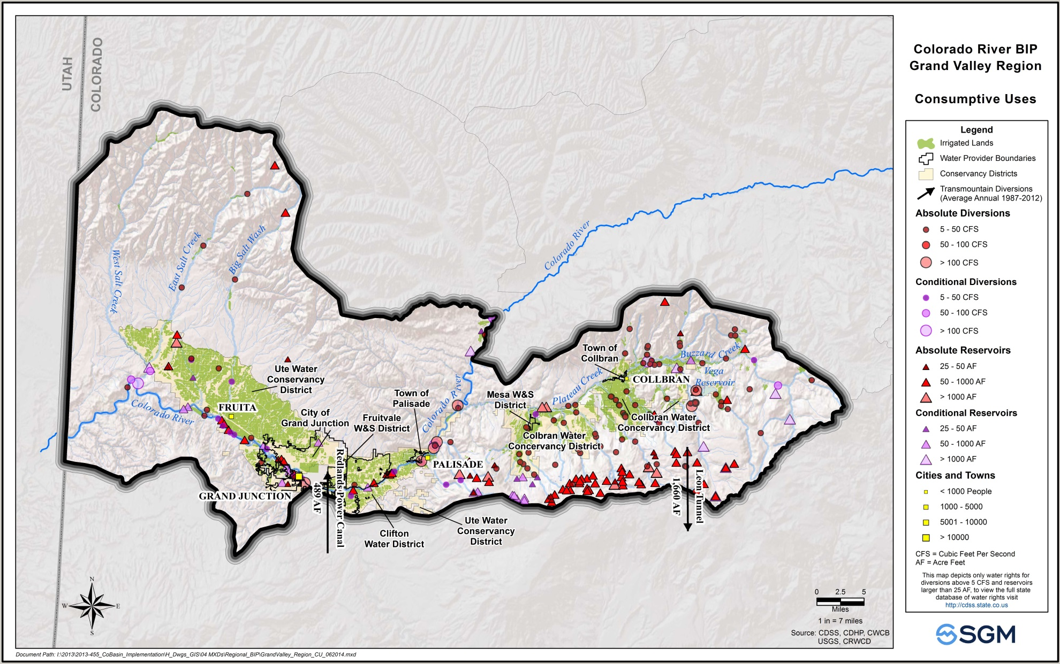
Grand Valley Water Uses

Slide 18
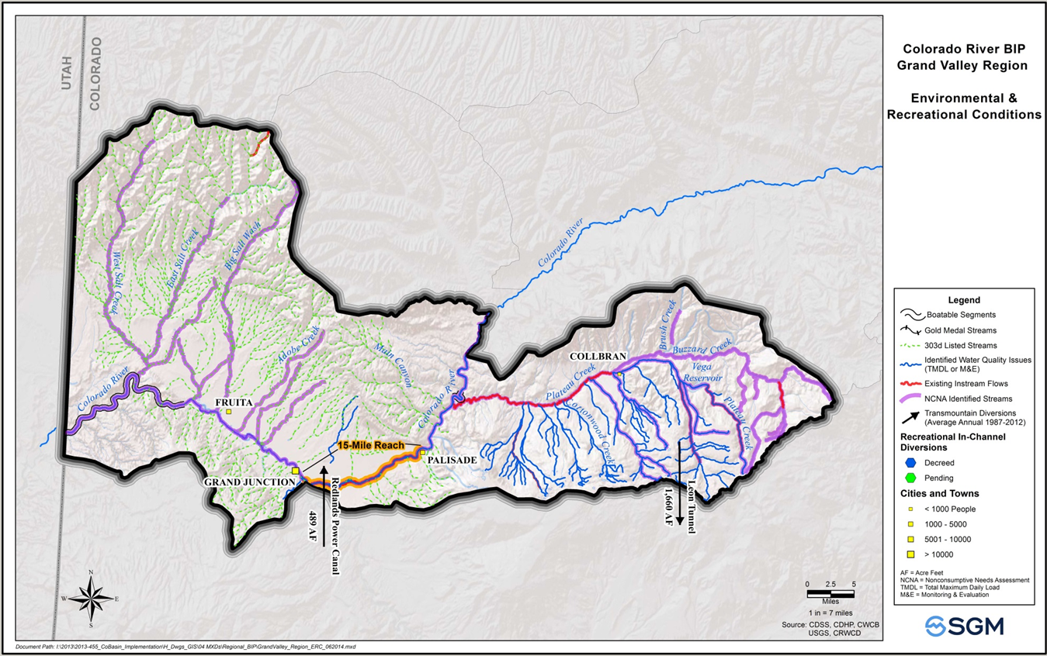
Grand Valley Stream Conditions
Notes:
Grand Valley tributaries to Colorado River that are impaired – mostly due to Selenium, some E Coli (Adobe Creek, Leach Creek), Iron (Indian Wash); Plateau Creek tributaries with water quality issues are highlighted because they are on a Monitoring & Eval list for Selenium and Iron.

Slide 19
Grand Valley Priority Projects
Draft List (v. 2/10/15)
Collbran Conservation District main canal improvements and siphon replacement
Hunter Reservoir
Monument Reservoir

Slide 20
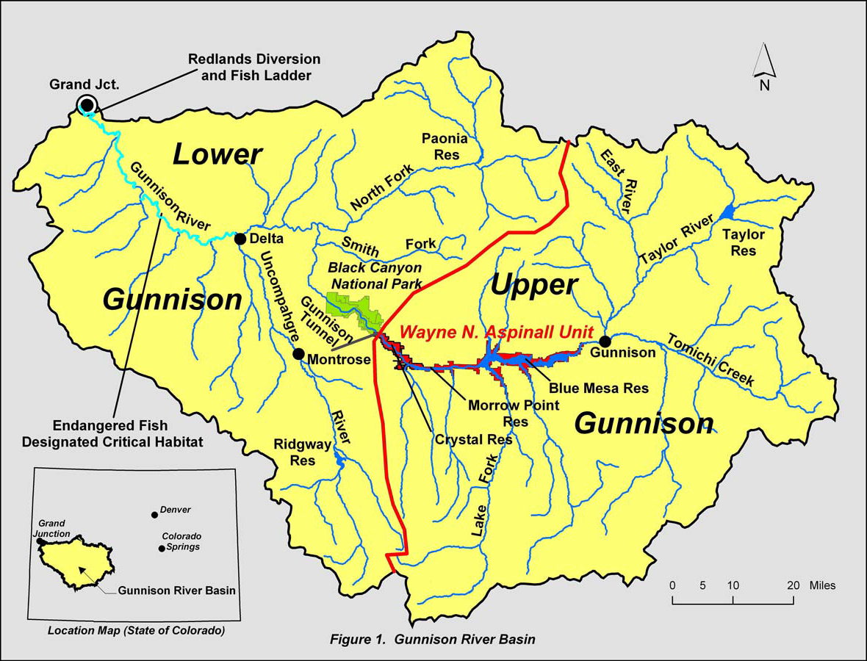
Gunnison Basin:
Notes:
-Needs assessed include consumptive needs (for agriculture and towns) and nonconsumptive needs (for the environment and recreation). You will hear more about these analyses from our next speakers.
-The Roundtable can direct funds to projects that will address identified needs.
- On this slide you can see the extensive area the Roundtable covers, as well as a couple of the key controlling “calls” on the river that keep it running the way we are used to.

Slide 21
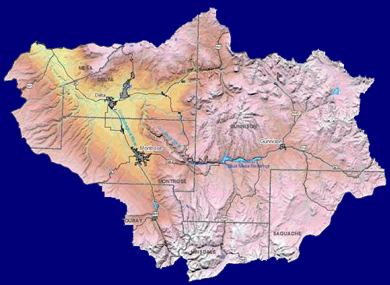
Gunnison Basin projects a relatively small 2050 M&I Gap....
~1% of the statewide Gap
MESA COUNTY
Max increase | 2,300
IPPs @ 90% | 2,000
Max Gap | 300
DELTA COUNTY
Max increase | 6,700
IPPs @ 90% | 4,400
Max Gap | 2,200
MONTROSE COUNTY
Max increase | 9,100
IPPs @ 90% | 7,700
Max Gap | 1,300
GUNNISON & SAGUACHE COs
Max increase | 3,800
IPPs @ 90% | 1,400
Max Gap | 2,400
OURAY COUNTY
Max increase | 800
IPPs @ 90% | 500
Max Gap | 300
Basin Total
Max increase | 23,000
IPPs @ 90% | 16,500
Max Gap | 6,500
HINSDALE COUNTY
All numbers are acre-feet.
Max increase | 300
IPPs @ 90% | 300
Max Gap | 30?

Slide 22
Most Basin agricultural producers have large shortages
(already a “Gap” situation in all water districts)
Water District | Acres Irrigated | AF of water required | AF of water available | Shortage
28 – Tomichi Creek | 28,400 | 63,600 | 43,900 | 19,700
40 – North Fork & Delta | 90,200 | 228,800 | 153,600 | 75,200
41 – Lower Uncompahgre | 79,800 | 175,700 | 172,800 | 2,900?
42 – Lower Gunnison | 8,300 | 24,900 | 18,700 | 6,200
59 – Upper Gunnison | 33,800 | 73,100 | 58,600 | 14,500
62 – Lake Fork | 16,500 | 34,700 | 32,000 | 2,700
68 – Upper Uncompahgre | 14,900 | 31,800 | 25,900 | 5,900
TOTAL | 272,000 | 632,600 | 505,500 | 128,000
ESTIMATES FOR 2050 | 219,000 | 573,000 | 457,000 | 116,000

Slide 23
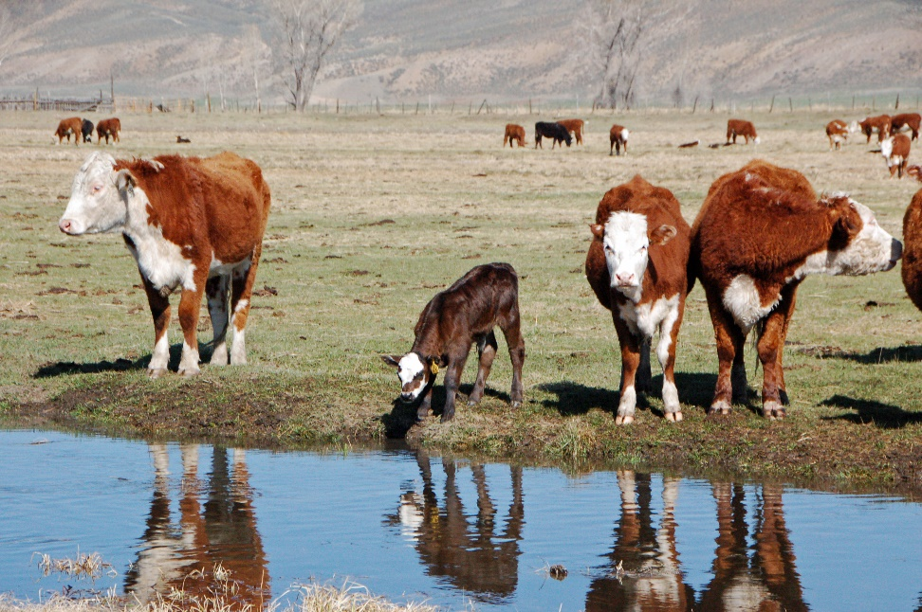
Analysis of Agricultural Needs
Physical shortages mostly reflecting a need for storage of water for late-summer and fall irrigation
Legal shortages due to calls from downstream senior users
Irrigation practice shortages caused by labor shortages, inefficient or deteriorating delivery systems, or other local infrastructure issues

Slide 24
Nonconsumptive Uses and Needs in the Gunnison Basin
This map shows important nonconsumptive water uses in the Gunnison River Basin – mostly environmental and recreational.
Roundtable members have iden-tified 21 stretches of the river and tributaries that now experience nonconsumptive use shortages.
Nonconsumptive
needs arise in both
environmental and recre-
ational uses:
~ Fish and floaters both
need late-season flows.
~ Water quality suffers as quantity lessens
and multiple reuse stresses the resource.
~ Ecological climate-change challenges.
yes
Conclusion: Additional consump-tive uses in the Basin will have nega- tive impact on nonconsumptive uses.

Slide 25
In-basin Goals for the Gunnison Basin
Primary Goal:
Protect existing water uses in the Gunnison Basin
Supporting Goals (Order does not indicate priority):
Discourage the conversion of currently productive agricultural land to other uses within the context of private property rights.
Improve agricultural water supplies to reduce shortages.
Identify and address municipal and industrial water shortages.
Quantify and protect nonconsumptive water uses.
Maintain and, where necessary, improve water quality in the Basin.
Describe, quantify and encourage beneficial relationships between agricultural and nonconsumptive water uses.
Restore, maintain, and modernize critical water infrastructure, including hydropower.
Maintain an active and comprehensive public education process about water resources in the Gunnison Basin.

Slide 26
Statewide Goals & Principles
(In summary)
Colorado River water supply is highly variable and uncertain; therefore proponents of new projects must accept all the risk of shortages.
New supply development anywhere in the Colorado River System will impact the entire Upper Colorado River Basin, due Compact obligations.
Any new project from the Colorado Basin must have identified sponsors and beneficiaries, and must meet minimum criteria on use of the water.
Demand management, conservation and reuse strategies must be employed prior to any new supply development from the Colorado Basin
Use Local or regional solutions, rather than a state project for future needs.
Water supply factors must be incorporated into land use planning.
Scenario planning should be used, given climate and economic uncertainties.
Gunnison Basin vision should be broadcast throughout the state through public education.

Slide 27
Gunnison Basin Plan Projects
Priority projects include measures to:
    Inventory of irrigation infrastructure needs.
    Repair and optimize reservoirs.
    Improve canal efficiency and capacity.
    Study feasibility of projects to benefit environmental & recreational values.
    Improve on-farm irrigation efficiency.
    Address municipal water needs.
    Increase hydropower production.

Slide 28
Your input is needed!
Next steps:
April 17, 2015 – Final Basin Plans submitted to the Colorado Water Conservation Board
May 1, 2015 – Public comment deadline for 1st draft statewide Colorado Water Plan
July 15, 2015 – 2nd draft statewide Colorado Water Plan released for public review
September 17. 2015 – Public comment deadline for 2nd draft statewide Colorado Water Plan
December 10, 2015 – Final Colorado Water Plan submitted to Governor.
Please:
Fill out your survey.
Sign up to get updates as planning progresses!

